Slide 1
PCA Algorithm-
The steps involved in PCA Algorithm are as follows-
Step-01: Get data.
Step-02: Compute the mean vector (µ).
Step-03: Subtract mean from the given data.
Step-04: Calculate the covariance matrix.
Step-05: Calculate the eigen vectors and eigen values of the covariance matrix.
Step-06: Choosing components and forming a feature vector.
Step-07: Deriving the new data set.

Slide 2
Numerical Example
Consider the two dimensional patterns (2, 1), (3, 5), (4, 3), (5, 6), (6, 7), (7, 8). Compute the principal component using PCA Algorithm.

Slide 3

The given feature vectors are-
x₁ = (2, 1)
x₂ = (3, 5)
x₃ = (4, 3)
x₄ = (5, 6)
x₅ = (6, 7)
x₆ = (7, 8)

Slide 4

Calculate the mean vector (µ).
Mean vector (µ) = ((2 + 3 + 4 + 5 + 6 + 7) / 6, (1 + 5 + 3 + 6 + 7 + 8) / 6)
= (4.5, 5)

Slide 5
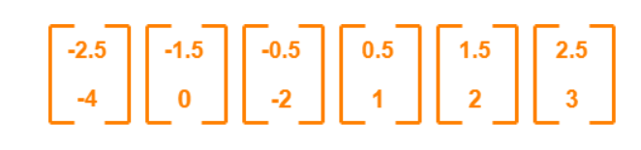
Subtract mean vector (µ) from the given feature vectors.
x₁ – µ = (2 – 4.5, 1 – 5) = (-2.5, -4)
x₂ – µ = (3 – 4.5, 5 – 5) = (-1.5, 0)
x₃ – µ = (4 – 4.5, 3 – 5) = (-0.5, -2)
x₄ – µ = (5 – 4.5, 6 – 5) = (0.5, 1)
x₅ – µ = (6 – 4.5, 7 – 5) = (1.5, 2)
x₆ – µ = (7 – 4.5, 8 – 5) = (2.5, 3)
Feature vectors (x_{i}) after subtracting mean vector (µ) are-

Slide 6
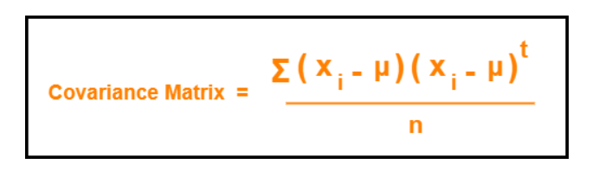
Calculate the covariance matrix.

Slide 7
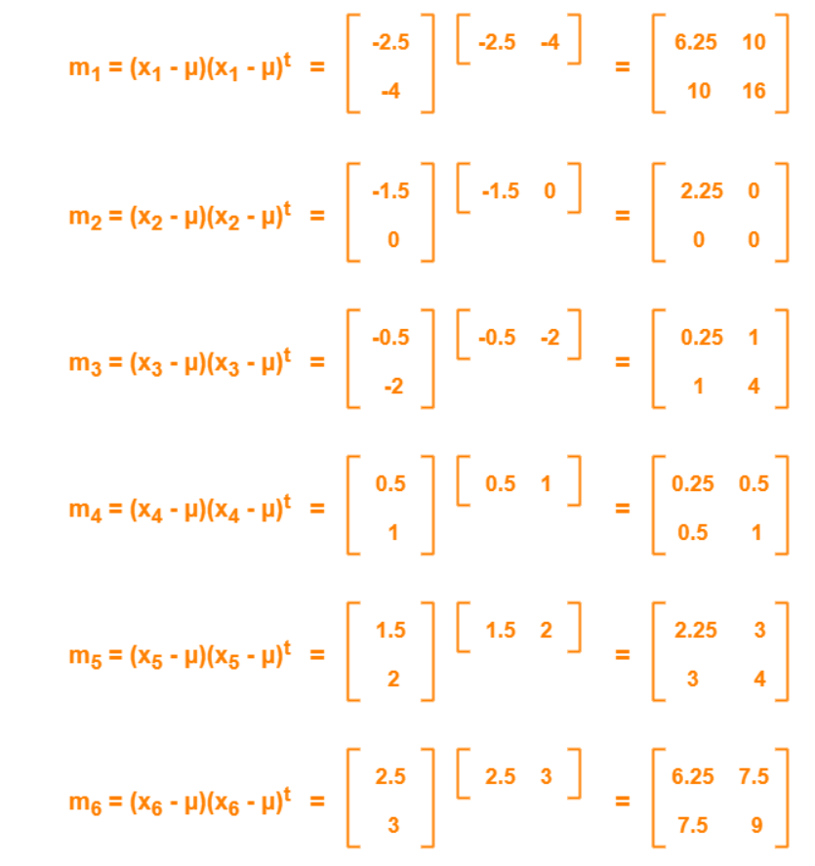

Slide 8
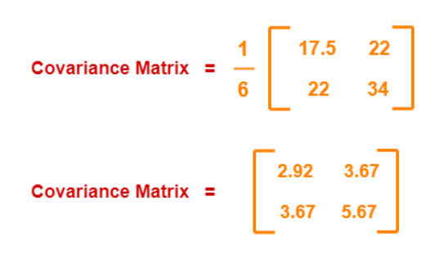
Covariance matrix = (m₁ + m₂ + m₃ + m₄ + m₅ + m₆) / 6

Slide 9
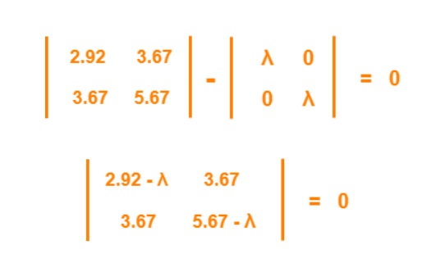
Calculate the eigen values and eigen vectors of the covariance matrix.
λ is an eigen value for a matrix M if it is a solution of the characteristic equation |M – λI| = 0.
So, we have-

Slide 10
From here,
(2.92 – λ)(5.67 – λ) – (3.67 x 3.67) = 0
16.56 – 2.92λ – 5.67λ + λ² – 13.47 = 0
λ² – 8.59λ + 3.09 = 0
Solving this quadratic equation, we get λ = 8.22, 0.38
Thus, two eigen values are λ₁ = 8.22 and λ₂ = 0.38.
Clearly, the second eigen value is very small compared to the first eigen value.
So, the second eigen vector can be left out.
Eigen vector corresponding to the greatest eigen value is the principal component for the given data set.
So. we find the eigen vector corresponding to eigen value λ₁.

Slide 11
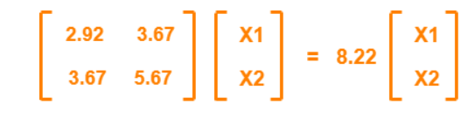
We use the following equation to find the eigen vector-
MX = λX
where-
M = Covariance Matrix
X = Eigen vector
λ = Eigen value
Substituting the values in the above equation, we get-

Slide 12

Solving these, we get-
2.92X₁ + 3.67X₂ = 8.22X₁
3.67X₁ + 5.67X₂ = 8.22X₂
On simplification, we get-
5.3X₁ = 3.67X₂ ………(1)
3.67X₁ = 2.55X₂ ………(2)
From (1) and (2), X₁ = 0.69X₂
From (2), the eigen vector is-

Slide 13

Thus, principal component for the given data set is-

Slide 14
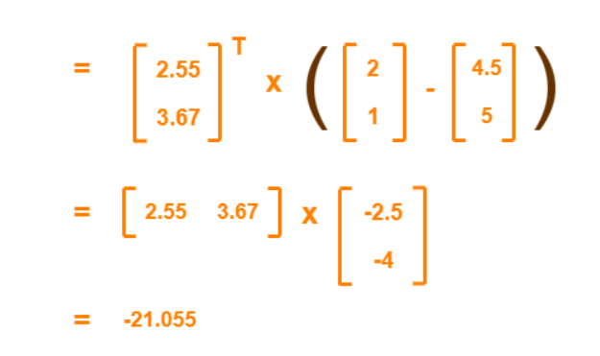
The feature vector (2,1) gets transformed to = Transpose of Eigen vector x (Feature Vector – Mean Vector)

